Slide 1
Olist E-Commerce Analysis
Azure SQL + T-SQL Database Analysis
Michael Amaya | Vanessa Quiroz | Jan Zika

Slide 2
Overview
About the Dataset
Goal
Brazilian e-commerce marketplace, data collected January 2017 – August 2018
11 tables | ~1.56 million rows
Orders, customers, sellers, products, payments, reviews, marketing leads
Analyze sales performance and customer behavior in a large e‑commerce marketplace
Jan: Sales & Revenue (Q01–Q04)
Michael: Customer & Delivery Behavior (Q05–Q08)
Vanessa: Seller & Product Performance (Q09–Q12)

Slide 3
Data Pipeline: SQLite → SQL Server
Source: single-file SQLite database (110 MB)
Python script:
  Parsed the SQLite data
  Generated SQL Server-compatible INSERT scripts for each entity
  Handled type conversion, scientific notation, FK ordering, and data validation
Scripts executed in SQL Server Management Studio to create and populate the database on local SQL Server
Database exported as a .bacpac file and uploaded to Azure SQL for team access
SQL Server database schema verified via an SQL script
  Verified data profile and types (sanity check)
  Compared the result to an SQLite script ran on the original SQLite database

Slide 4
ER Diagram

Slide 5
Sales & Revenue
Jan Zika | Q1–Q4

Slide 6
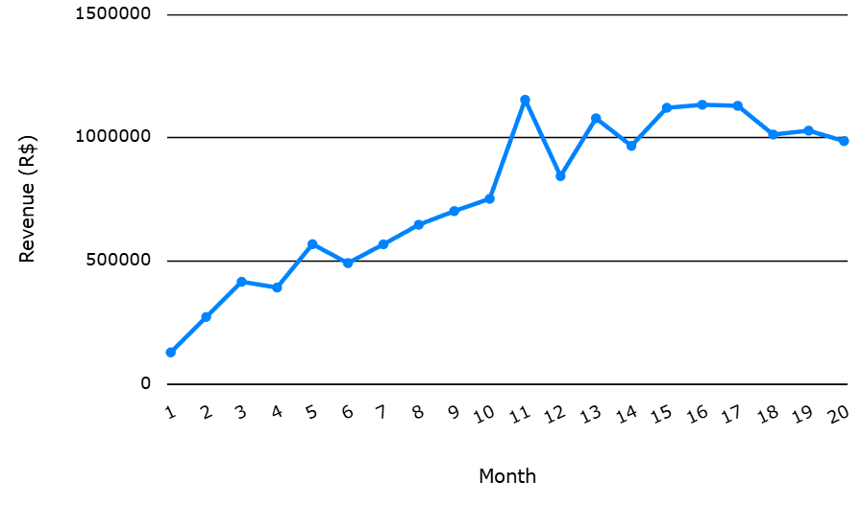
Revenue Trends
Q1 (+ View)
Revenue grew 9x from January 2017
to peak in November 2017
— potential seasonality
(Black Friday effect)
Average monthly growth was 15%
Revenue plateaued in 2018 around R$1M

Slide 7
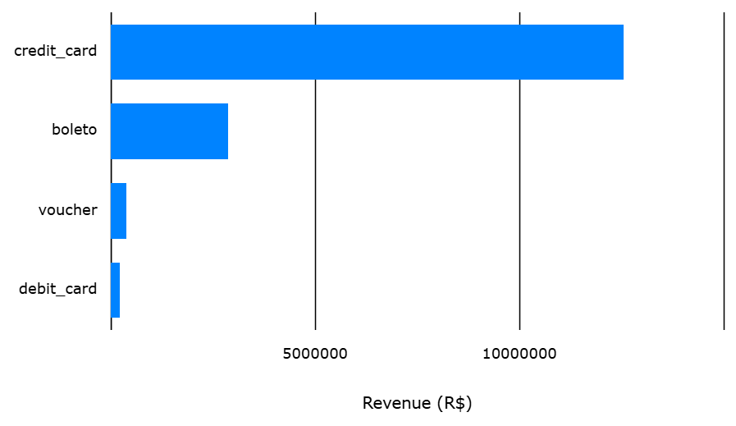
Payment Methods
Q2 (+ View)
Credit cards dominate
— CC purchases split to 3.5 installments on average, confirms that installment culture is important in Brazilian e-commerce
Boleto (bank slip) second
— no card required

Slide 8
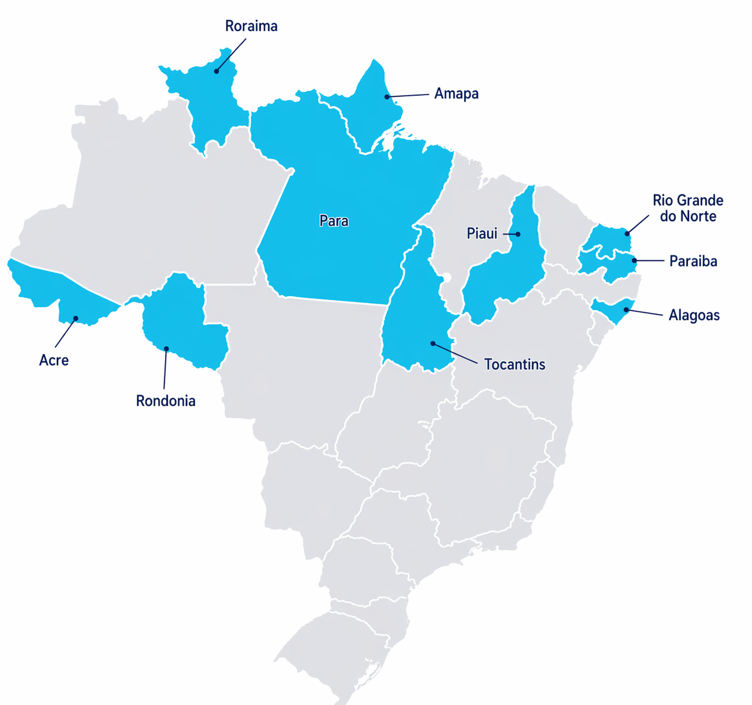
Order Value by State
Q3 (+ Stored Procedure)
Top 10 highest avg order value are all North/Northeast states
Paraíba highest: average product value
R$192 + freight R$43 = R$235 total
Higher product values
— not just freight inflation

Slide 9
Top 10 Categories by revenue
Q4
Health & beauty
is #1 category
by revenue: R$1.44M
Watches & gifts #2
Bed/bath/table #3
— lifestyle over electronics

Slide 10
Customer & Delivery Behavior
Michael Amaya | Q5–Q8

Slide 11
Delivery Time & Customer Reviews
Q5
Q6
TODO
TODO

Slide 12
Order Insights
Q7
Q8
TODO
TODO

Slide 13
Seller & Product Performance
Vanessa Quiroz | Q9–Q12

Slide 14
Top Seller & Product Categories
Q9
Q10
TODO
TODO

Slide 15
Lead Sources & Freight Cost
Q11
Q12
TODO
TODO

Slide 16
Visualizations
Revenue | Jan Zika
Payment Methods | Jan Zika
Review Score | Michael Amaya
Freight Cost | Vanessa Quiroz

Slide 17
Revenue by Month

Slide 18
Payment Methods Breakdown

Slide 19
Review Score Distribution

Slide 20
Freight Cost vs Product Weight

Slide 21
Bonus: Geolocation
Jan Zika | View + Q13

Slide 22
The Geography of Brazilian E-Commerce
City Route | Order Count | Average Distance (miles) | Average Freight Cost (R$)
São Paulo → São Paulo | 6,895 | 11 | 10.26
São Paulo → Rio de Janeiro | 2,396 | 233 | 18.58
Ibitinga → São Paulo | 1,957 | 195 | 14.14
São Paulo → Belo Horizonte | 1,063 | 312 | 16.96
Ibitinga → Rio de Janeiro | 897 | 388 | 18.32
Santo André (SP) → São Paulo | 756 | 16 | 10.13
São José (SP) → São Paulo | 713 | 55 | 10.43
São Paulo → Goiânia | 641 | 505 | 15.71
São Paulo → Brasília | 609 | 544 | 17.33
São Paulo → Curitiba | 595 | 226 | 17.37
Sao Paulo is basically Amazon Brazil
  One city shows up in 8 of the top 10 shipping routes.
  The SP→SP route alone beats the next three routes combined.
Ibitinga who?
  A town of 60,000 people
  Brazil's #2 seller city. Zero name recognition, but shipping textiles/craft to the entire country. Specialization > size.
533 miles for R$ 7 (~ $1.40) extra
  Shipping from Sao Paulo to Brasilia costs about the same as shipping across town.
  Distance barely moves the needle on freight
Rio de Janeiro
  All vibes, no warehouses
  RJ is a top destination on two routes but nowhere to be found as a seller. The city buys. It does not ship.

Slide 23
References
Dataset: https://www.kaggle.com/datasets/terencicp/e-commerce-dataset-by-olist-as-an-sqlite-database
Project Repo: https://github.com/jan-zika/olist-db
Database: Azure SQL
Tools: SSMS, Azure SQL, Python, DBCode, dbdiagram.io

Slide 24
Questions?

